Slide 1
NMDS ordination with individually selected labels
GLEON Fellowship Workshop
January 14-18, 2013
Sunapee, NH
Emily Nodine

Slide 2
Skill definition
NMDS ordination plots site-species data based on their similarity
Helps to visualize which sites contain communities that overlap or are very different
Both sites and species have defined positions in the plot, but the
output gets
cluttered very
quickly
Need tools for
selectively
labeling individual
sites and species
Transform: Square root
Resemblance: S17 Bray Curtis similarity
UCP02
2D Stress: 0.11
UCP01
BIP04
BIP06
BIP01
UCP04
UCP03
BIP03
OHP06
UCP05
BIP05
BIP02
UCP06
MRP01
OHP08
OHP07
OHP04
OHP05
LPP08
OHP03
LPP01
LPP07
LPP05
LPP03
LCP03
MRP02
UPP01
OHP02
LPP06
LPP04
LPP09
LPP02
UCP07
UPP05
UPP07
UPP03
OHP01
LCP05
MRP03
UPP10
UPP09
LCP04
LCP01
UPP06
UPP02
UPP08
MRP04
UPP11
LCP02
UPP04
NMDS ordination of diatom communities across 50 sites
(done using Primer and PowerPoint).

Slide 3
Skill relevance/usefulness
NMDS is easily performed using other programs, but not customizable
Have to save to PowerPoint and then manipulate output (time-consuming)
R can do it all at once with appropriate code (still working on this, but I’m sure it’s true)
Easy to make adjustments once code is complete

Slide 4
Application to data
Applied to Charlotte Harbor diatom data from 50 sites
Many functions are designed to allow flexibility in plotting (all in vegan package, which also does NMDS)
Ordiplot allows you to choose which features to label
Ordilabel prioritizes labels so most frequent are most easily seen
Orditkplot allows to move the labels around manually to reduce clutter
Identify allows you to select specific features of the plot to label
Haven’t yet found the perfect combination

Slide 5
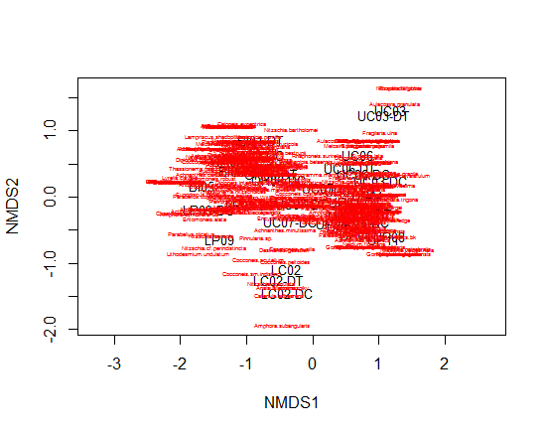
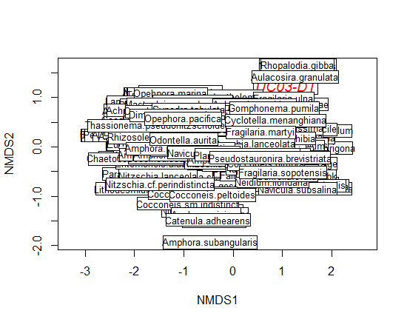
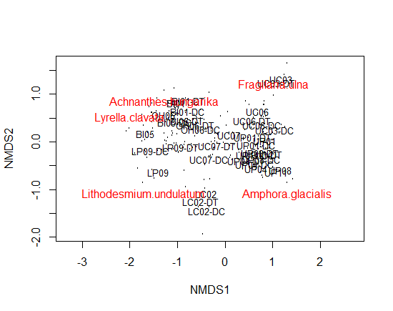
Progress so far…
Ordilabel prioritizes most abundant species, but you can’t see anything else
Ordiplot lets you customize labels
Best attempt so far: using ordiplot to label sites with text and species as dots and then identify to select which species to label
Goals: further reduce clutter, color code groups, and choose species to be labeled based on abundance rather than location

