Slide 1
Interaction of GIS and R
GLEON Fellowship Workshop
January 14-18, 2013
Sunapee, NH
Amy Hetherington
Notes:
Good Morning, Everyone! Today, I will demonstrate the interaction of GIS and R by calculating the volume of runoff from each subbasin within a watershed.

Slide 2
Skill Definition – R Packages
Capabilities of R are extended through user-created packages.
Packages are developed primarily in R, and sometimes in Java, C, and Fortran.
A core set of packages are included with the installation of R, with 5300 additional packages (as of April 2012) available at the Comprehensive R Archive Network (CRAN) and other repositories.
Notes:
Capabilities of R are extended through user-created packages, which allow specialized statistical techniques, graphical devices, import/export capabilities, reporting tools, and many other functions.
Packages are developed primarily in R, and sometimes in Java, C, and Fortran.
A core set of packages are included with the installation of R, with 5300 additional packages (as of April 2012) available at the Comprehensive R Archive Network (CRAN) and other repositories.

Slide 3
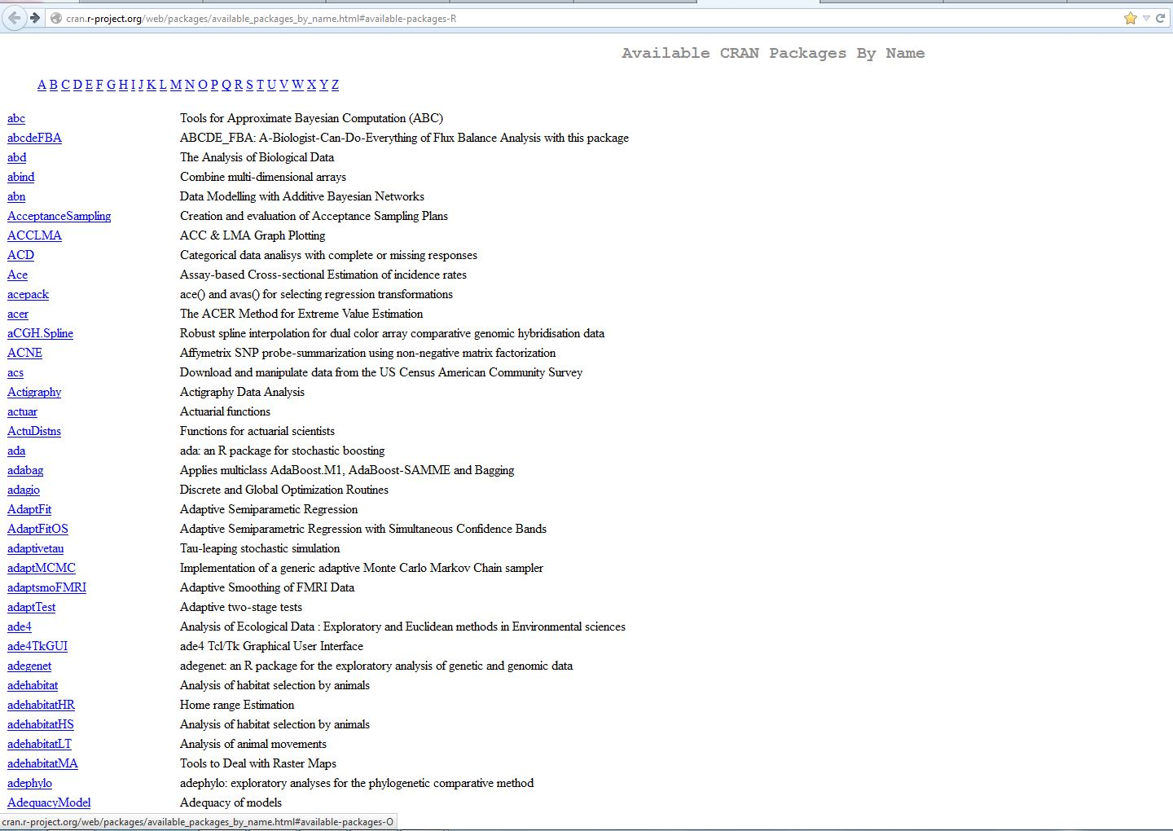
Comprehensive R Archive Network (CRAN)
Notes:
Here is a picture of the Available CRAN packages by name.

Slide 4
Skill Relevance/Usefulness
Shapefiles package includes functions to read and write ESRI shapefiles.
ESRI shapefiles consist of three files.
*.shp contains the geography of each shape.
*.shx is an index file which contains record offsets.
*.dbf contains feature attributes.
read.shapefile calls read.shp, read.shx, and read.dbf to read in an entire shapefile.
Allows further geostatistical analysis
Notes:
The Shapefiles package is one such package available in the Comprehensive R Archive Network which includes functions to read and write ESRI shapefiles.
ESRI shapefiles consist of three files.
*.shp contains the geography of each shape.
*.shx is an index file which contains record offsets.
*.dbf contains feature attributes.
read.shapefile calls read.shp, read.shx, and read.dbf to read in an entire shapefile.
This package is important because it allows further geostatistical analysis of shapefiles in R.

Slide 5
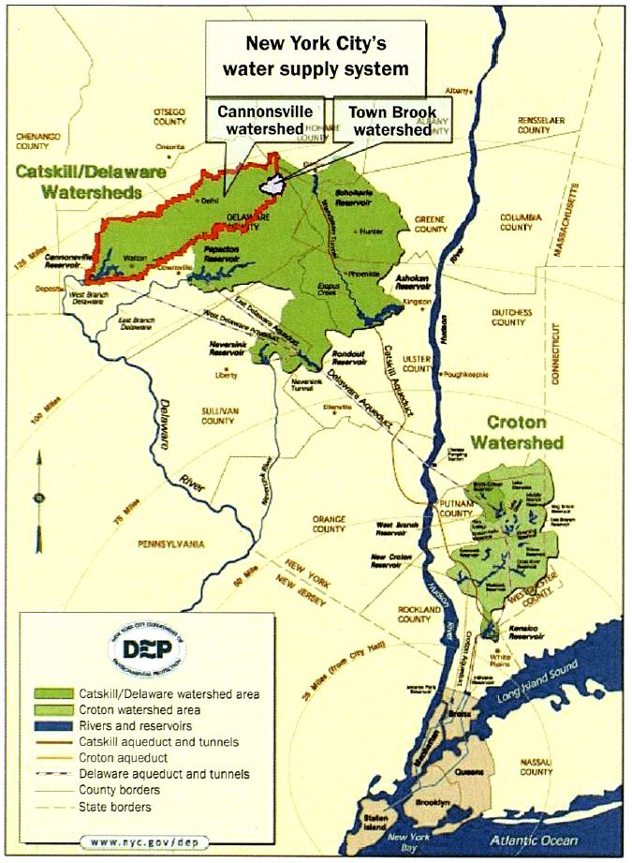
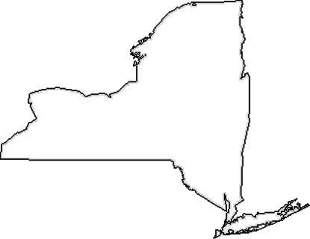
New York City’s Water Supply System with Locations of
Town Brook Watershed within Cannonsville Watershed
Identified (Bryant et al., 2008)
Notes:
I’ll demonstrate the R shapefiles package using the Town Brook watershed located in downstate New York.
The 37 km² Town Brook watershed is a subwatershed of the Cannonsville watershed which is all part of New York City’s water supply system.

Slide 6
Skill Application
Calculate the volume of runoff from each subbasin within Town Brook watershed
Read Shapefile
Area of Subbasins (m²)
Read Table
Precipitation (mm)
Calculate Volume
Volume (m³) = Area of Subbasins (m²) * Precipitation (mm)/1000
Lessons Learned
Comment Code
Build Unique Variables
Distinct Names (Mean)
Extended Names (NetPrecip vs. NP)
Notes:
The goal was to calculate the volume of runoff from each subbasin within the Town Brook watershed to identify hydrological active areas (HAAs) which are key to protecting water quality.
First, R read the Town Brook watershed shapefile for the Area of the Subbasins.
Next, R read a table containing precipitation.
Last, R calculated Volume in m³ as the Area of the Subbasins in m² times Precipitation in mm/1000.
Lessons learned include the importance of
Commenting your code for future reference for yourself and others, AND
Building unique variables
Do not have variable names similar to language functions (For example, do not have a variable named mean as it is a function.)
Use extended variable names for future reference (For example, use NetPrecip instead of NP)

Slide 7
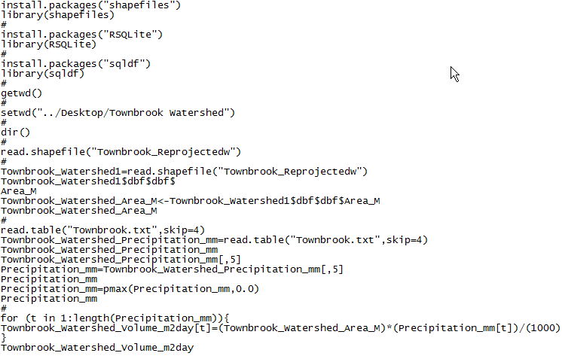
Skill Results
Setup
Shapefile
Area
Precipitation
Volume
Notes:
This is a summary of the code used to calculate the volume of runoff from each subbasin within the Town Brook watershed.
Let’s review it at a high-level.
The first section is set-up.
Next is reading the shapefile.
Then, identification of the area and precipitation.
Last is calculating the volume.

Slide 8
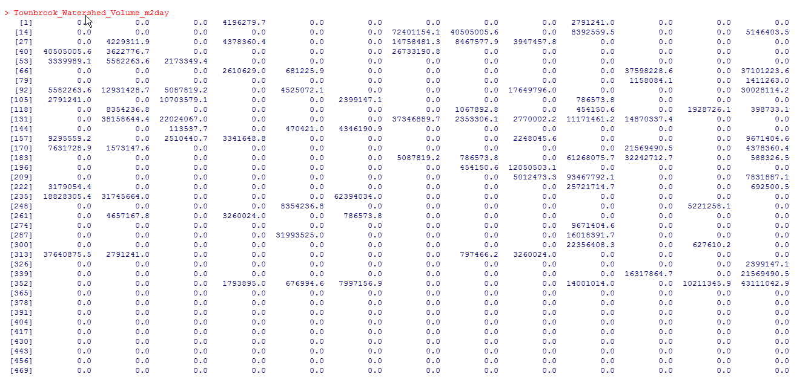
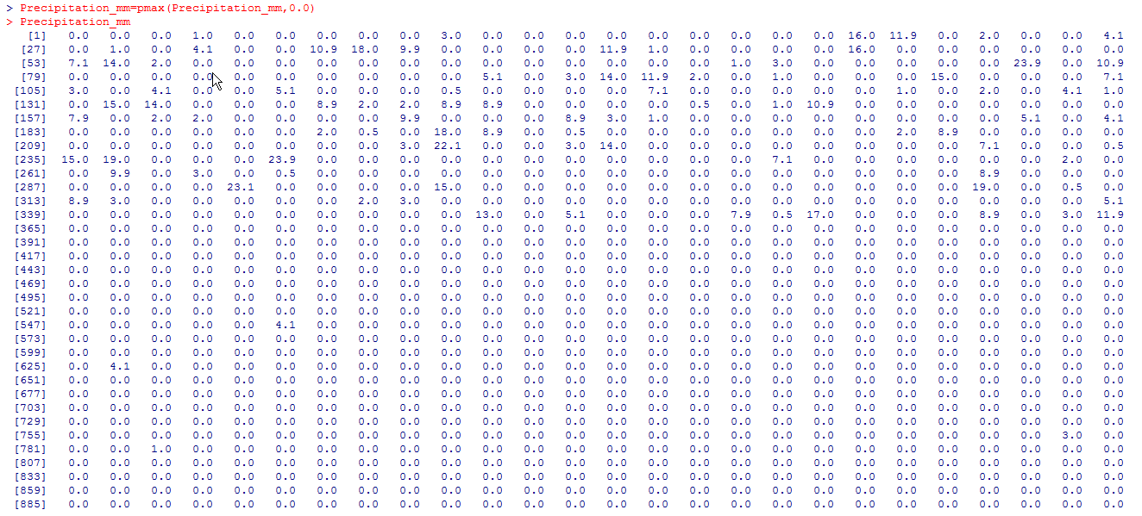
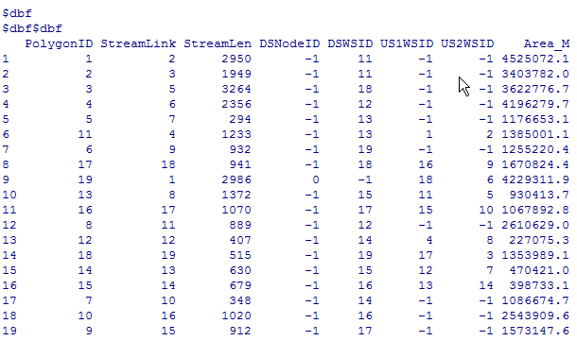
Skill Results
Notes:
Here are the results of the main sections which amounts to a lot of numbers for the shapefile, area, precipitation, and volume.

Slide 9
Conclusion
Capabilities of R are extended through many user-created packages.
Shapefiles package includes functions to read and write ESRI shapefiles.
Shapefiles package allows further geostatistical analysis
Calculating the volume of runoff from each subbasin within a watershed
Remember to comment code and build unique variables
Notes:
In summary, R contains many packages which extend its capabilities.
The Shapefiles package is and example which includes functions to read and write ESRI shapefiles.
The Shapefiles package allows further geostatistical analysis in R such as calculating the volume of runoff from each subbasin within a watershed.
It’s important to remember to comment code and build unique variables in R.

Slide 10
Thank You

