Slide 1
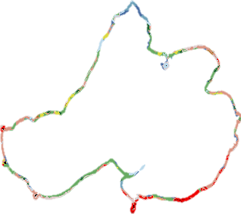
Spatial Processing in R
Luke Winslow

Slide 2
Task
Calculate a buffer around a lake
Create a Shapefile for just the buffer
Extract Land/Cover Land/Use for buffer from national database

Slide 3
Lake Mendota
mendota = readOGR('.','mendota')
mendotaProj = spTransform(mendota,CRS("+proj=cea"))
plot(mendotaProj)

Slide 4
Buffer Shape
mendotaBuffer = gBuffer(mendotaProj,width=100)
plot(mendotaBuffer)

Slide 5
Combining Shapes
# Now we need to turn the original mendota
# shape into holes for the buffer
newHoles = mendotaProj@polygons[[1]]@Polygons
#Reverse each to make holes filled and vice-versa
for(i in 1:length(newHoles)){
#Tell the polygon to switch being hole/not hole
newHoles[[i]]@hole = !newHoles[[1]]@hole
#reverse direction of coordinates (also means hole/not hole)
newHoles[[1]]@coords = apply(newHoles[[1]]@coords,2,rev)
}

Slide 6
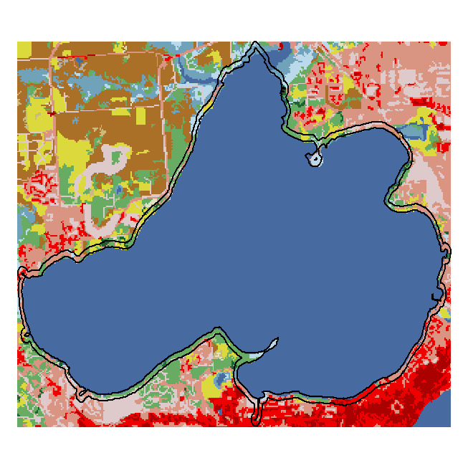
nlcd = raster(nlcdPath)
meBuffProj = spTransform(mendotaBuffer,nlcd@crs)
nlcdCropped = crop(nlcd,meBuffProj)
#This is the buffer with the NLCD raster overlaid
plot(nlcdCropped,add=T)
plot(meBuffProj,add=T,lwd=2)

Slide 7
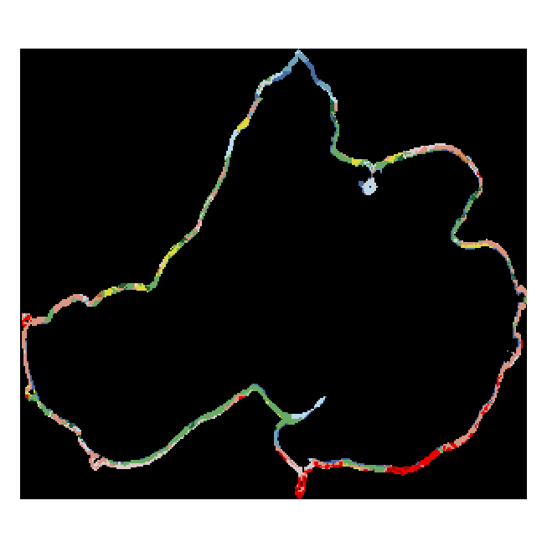
meMasked = mask(nlcdCropped,meBuffProj)
meMasked@legend = nlcd@legend
plot(meMasked)

Slide 8
Success!
freq(meMasked)
value count
[1,] 11 442 ←Open Water
[2,] 21 377 ←Developed, Open
[3,] 22 1166 ←Developed, Low
[4,] 23 328 ←Developed, Medium
[5,] 24 50 ←Developed, High
[6,] 41 1048 ←Deciduous Forest
[7,] 42 138 ←Evergreen Forest
[8,] 43 25 ←Mixed Forest
[9,] 52 6 ←Scrub
[10,] 71 2 ←Grassland/Herbacious
[11,] 81 255 ←Pasture/Hay
[12,] 82 33 ←Cultivated Crop
[13,] 90 285 ←Woody Wetland
[14,] 95 175 ←Emergent Herb. Wetland

