Slide 1
Getting graphs ready for publication
GLEON Fellowship Workshop
January 14-18, 2013
Sunapee, NH
Jessica Corman

Slide 2
ggplot2
Pro: great for quickly visualizing data
Data: Nutrient bioassay results, performed 4 x per year with phytoplankton from different depths in the lake
http://docs.ggplot2.org/current/

Slide 3
basic graphing in ggplot2
Library(ggplot2)
plotname <- ggplot(data, aes(x = xname, y = yname) + geom_point()
ggplot2 graphics work with layers
http://docs.ggplot2.org/current/

Slide 4
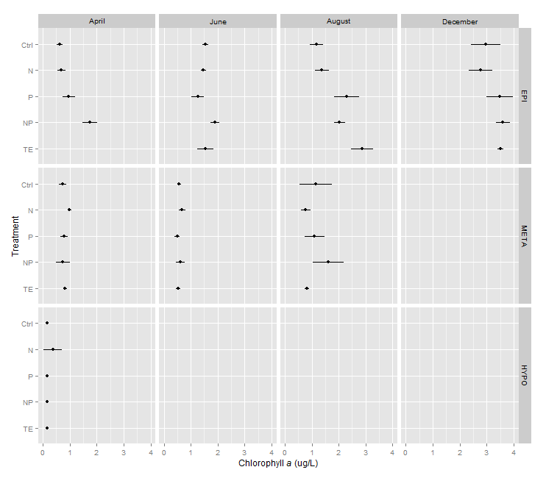
plotname + facet_grid(Depth ~ Month)

Slide 5
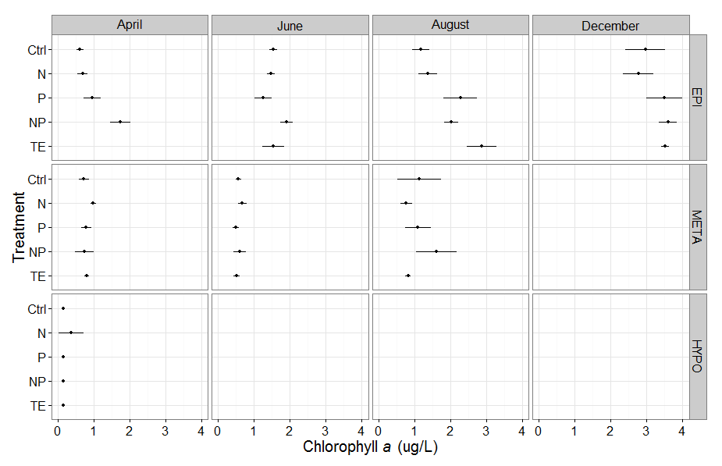
theme_set(theme_bw(16)) #set theme to black & white, increase font

Slide 6
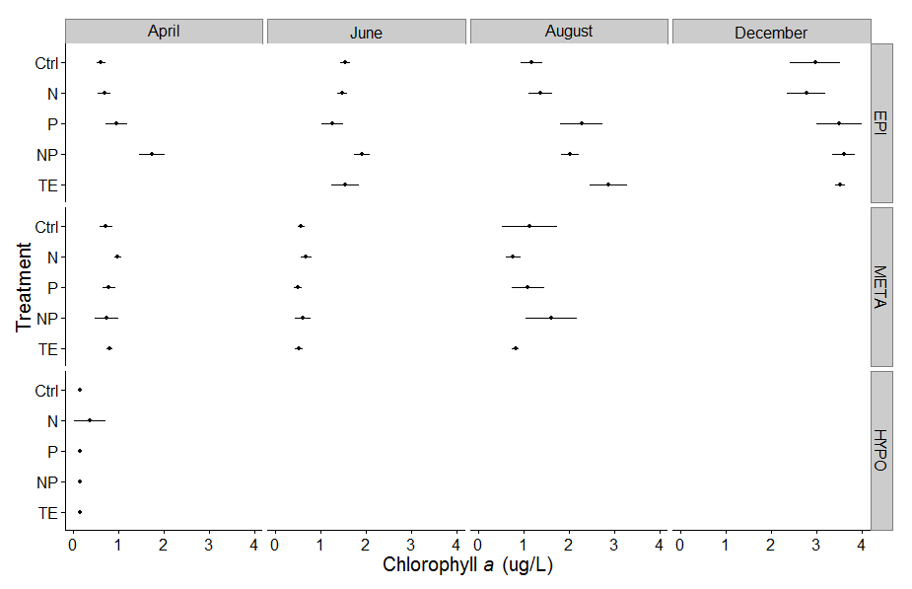
Goal: No gridlines, half-open plots
Using single plot fix doesn’t work in multi-panel plots
+ theme(panel.border = theme_blank(),
panel.grid.major = element_blank(),
panel.grid.minor = element_blank(),
axis.line = theme_segment())

Slide 7
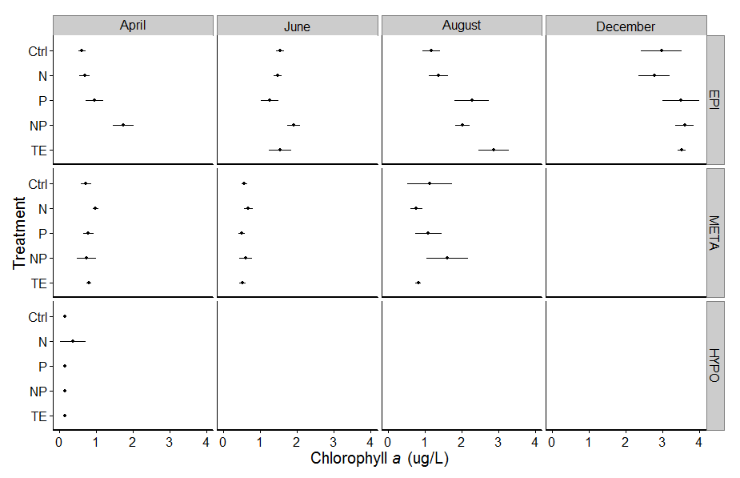
Goal: No gridlines, half-open plots

Slide 8
No gridlines, half-open plots
base2 <- ggplot(cdata2, aes(y=Chl, x=Treatment)) +
ylab(ytitle) +
geom_point(stat = "identity") +
geom_linerange(aes(ymin=Chl-sd, ymax=Chl+sd)) +
coord_flip() +
theme(
panel.border = theme_L_border(),
panel.grid.major = element_blank(),
panel.grid.minor = element_blank())
base2 + facet_grid(Depth ~ Month, margins = FALSE, labeller=label_parsed) ##dot chart with se!!

Slide 9
code for theme_L_border()
theme_L_border <- function(colour = "black", size = 1, linetype = 1) {
# use with e.g.: ggplot(...) + theme( panel.border=theme_L_border() ) + ...
structure(
list(colour = colour, size = size, linetype = linetype),
class = c("theme_L_border", "element_blank", "element")
)
}
element_grob.theme_L_border <- function(
element, x = 0, y = 0, width = 1, height = 1,
colour = NULL, size = NULL, linetype = NULL,
...) {
gp <- gpar(lwd = len0_null(size * .pt), col = colour, lty = linetype)
element_gp <- gpar(lwd = len0_null(element$size * .pt), col = element$colour, lty = element$linetype)
polylineGrob(
x = c(x+width, x, x), y = c(y,y,y+height), ..., default.units = "npc",
gp = modifyList(element_gp, gp),
)
}

Slide 10
code for theme_L_border()
theme_L_border <- function(colour = "black", size = 1, linetype = 1) {
# use with e.g.: ggplot(...) + theme( panel.border=theme_L_border() ) + ...
structure(
list(colour = colour, size = size, linetype = linetype),
class = c("theme_L_border", "element_blank", "element")
)
}
element_grob.theme_L_border <- function(
element, x = 0, y = 0, width = 1, height = 1,
colour = NULL, size = NULL, linetype = NULL,
...) {
gp <- gpar(lwd = len0_null(size * .pt), col = colour, lty = linetype)
element_gp <- gpar(lwd = len0_null(element$size * .pt), col = element$colour, lty = element$linetype)
polylineGrob(
x = c(x+width, x, x), y = c(y,y,y+height), ..., default.units = "npc",
gp = modifyList(element_gp, gp),
)
}
Available with call:
source("http://egret.psychol.cam.ac.uk/statistics/R/extensions/rnc_ggplot2_border_themes_2013_01.r”)
And many thanks for Rudolf Cardinal and ggplot2 listserv for writing the update!!

