Slide 1

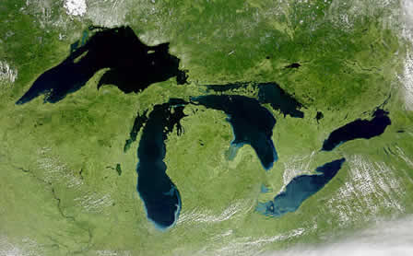





Team Science
Emily Read
GLEON Fellowship Program January 2013 Workshop
Sunapee, NH

Slide 2

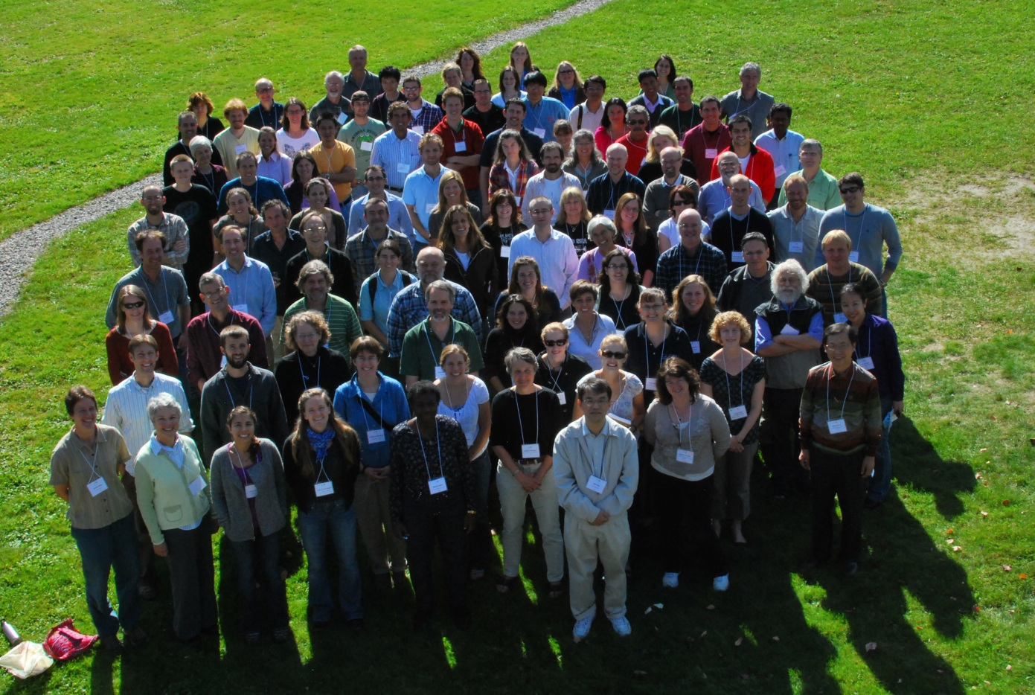
Grass roots, with a great diversity of projects
GLEON focuses on people, and provides a framework to enable innovation by all participants.
GLEON 13, Sunapee, New Hampshire, 2011
Embraces the diversity of sites, sensors, and people inherent in the global community

Slide 3
Today’s talk
What is team science and why is it important?
Are you willing and prepared to engage in team science?
Factors contributing to successful teams
Best practices to maximize team efficacy and productivity
How to lead team science
Strategies to address challenges and common pitfalls that research teams encounter

Slide 4
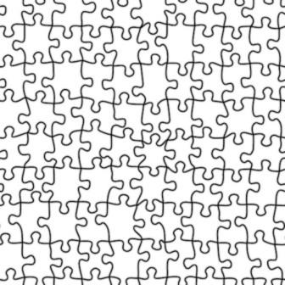
The structure of this talk
Communication
Trust
Dealing with conflict
Setting expectations

Slide 5
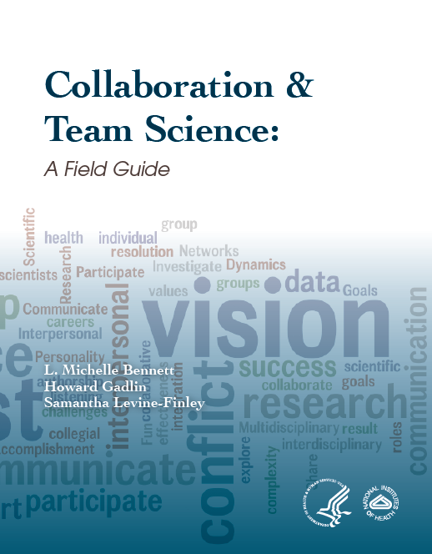

Slide 6
Defining collaborative, team science
Individually, read Box 1 from Eigenbrode et al. (2007) Employing philosophical dialogue in collaborative science. BioScience 57:55-64
With a partner, identify key differences between
Disciplinary vs. Cross-disciplinary collaborations
Multidisciplinary vs. Interdisciplinary vs. Transdisciplinary collaborations
Notes:
Disciplinary: used to describe types of knowledge, expertise, skills, people, projects, communities, problems, challenges, studies, inquiry, approaches, and research areas that are strongly associated with academic areas of study, or areas of professional practice (professions)
Multi: refers to knowledge associated with more than one existing academic discipline or profession

Slide 7
The collaborative spectrum
Transdisciplinary research
Interdisciplinary research
Multidisciplinary research
Disciplinary research
Integrated research team
Collaboration
Independent research
Level of interaction and integration

Slide 8
Why is team science important?
Complex science questions require collaboration

Slide 9
Inter- and trans-disciplinary questions
How does the passage of electrical signals among neurons in the human brain generate such a subtle and complex array of behaviors?
How will changes in the earth’s atmosphere affect climate, glaciers, and the oceans?
What combination of biological, environmental, and social factors accounts for the increase in obesity rates observed in many parts of the world?
How can innovations in agriculture feed a growing human population?

Slide 10
Interdisciplinary science addressed by GLEON members
How do physical and biological processes control dissolved oxygen variability over scales of minutes to days?
  Ecology, ecosystem science and computer science: Langman et al. 2010
Create a software tool to process high frequency physical lake data and output meaningful physical indices
  Physical limnology, ecology, hydrodynamics, civil engineering: Read et al. 2011
How do weather-related episodic events affect water quality globally?
  Limnology, ecology, physical limnology, biogeochemistry: Jennings et al. 2012
What is the ability of an aquatic ecosystem model to predict high-frequency harmful algal blooms?
  Limnology, ecology, microbial ecology, physical limnology, ecosystem modeling, computer science: Kara et al. 2012

Slide 11
Why is team science important?
Complex science questions require collaboration
Funding agencies (e.g., NIH) and societies (e.g., NAS) have recognized this
You will likely be asked to participate in or lead a collaborative team science project in the future
Understanding best practices for team science will improve other professional interpersonal interactions
  Mentor-protégé relations, collaborations, personal relationships (?)

Slide 12
Are you prepared to
  Give and receive constructive feedback
  Share data, credit, and decision making with team members
Recognize that others don’t necessarily share your understanding and perceptions
Consider many options and possibilities for how others perceive an experience
Appreciate that different understandings and perceptions of experiences do not have to threaten your identity and relationships

Slide 13
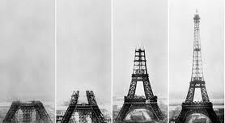
Best practices for building a research team

Slide 14
Best practices for building a research team
Made of diverse members, backgrounds, and experiences
Each member understands responsibilities, roles, and how they contribute to team goals
Practice open communication
Prepare for disagreement and conflict, especially in the early stages
Agree for a process for sharing data, establishing and sharing credit, and managing authorship
Regularly consider new perspectives and ideas related to research

Slide 15
Fostering trust
Model and teach team members how to give feedback that is both critical and supportive
  Hold regular meetings where each team member both shares data/progress and gives feedback on others’ data/progress
Structure activities that allow team members to learn about each other through various interactions
Encourage debate and exchange
Develop a process to handle disagreements over science or lab issues

Slide 16
Within team communication
Team members develop a common language for the project, eliminate or clearly define discipline-specific jargon, and translate across disciplines
Open discussion, differing opinions, and constructive criticism are encouraged and lead to healthy scientific dialogue
Team members share recognition of each others’ contribution to the research
→ Over time, team members have the capacity to integrate the perspectives of others into their thinking and hypothesis generation

Slide 17
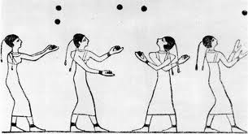
Best Practices for
Team Science
http://www.juggling.org/papers/history-1/
Develop a shared vision
Unambiguously assign or negotiate roles and responsibilities
Establish a process and criteria for determining authorship early
→ In public presentations, identify team members and explicitly acknowledge their contributions

Slide 18
Establishing expectations:
Develop a shared vision
Fast-forward to the end of the project and imagine a complete success- what would it look like?
What are the barriers to achievement?
Who ‘owns’ the barriers?
What will you do to remove the barriers?

Slide 19
After writing the vision statement…
Ensure that all members can describe the team’s goal or ‘big picture’
Encourage team members to articulate their own goals and how it fits into the big picture
Encourage team members to accept responsibility and be accountable for accomplishments and failures, without blaming
Encourage sharing and mutual learning across disciplines to enhance overall vision

Slide 20

Establishing expectations:
Create a collaborative agreement
State the goals of the project and how each member will contribute towards those goals
Delineate how to handle communications, data sharing, differences of opinion, and project management issues
Administrative aspects

Slide 21
Fellowship Program
Collaborative
Agreement

Slide 22
Fellowship Program
Collaborative
Agreement

Slide 23
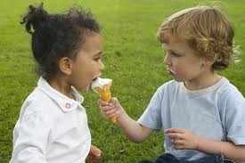
Sharing recognition and credit:
Talking about authorship
(early and often)
Case Study 13
Review and agree on criteria for authorship
Consider the CSI-Limnology (NSF MSB) model

Slide 24
Talking about authorship:
The CSI-Limnology NSF MSB model

Slide 25
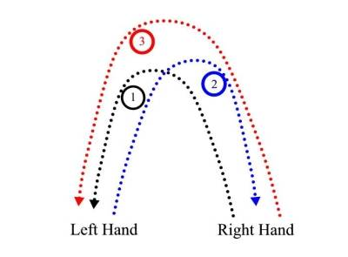
Best Practices for
Team Science
Shared vision
Clearly defined roles and responsibilities
Establish a process and criteria for determining authorship early
→ Establishing trust takes work!

Slide 26
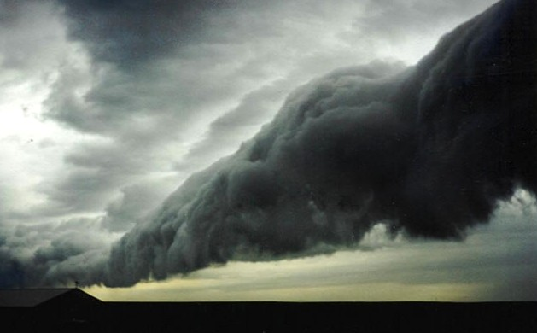
When team science gets tough

Slide 27
The challenges of cross-disciplinary research from Eigenbrode et al. 2007
Level of integration
Linguistic and conceptual divides
Validation of evidence
Societal context of research
Perceived nature of the world
Reductionistic versus holistic science

Slide 28
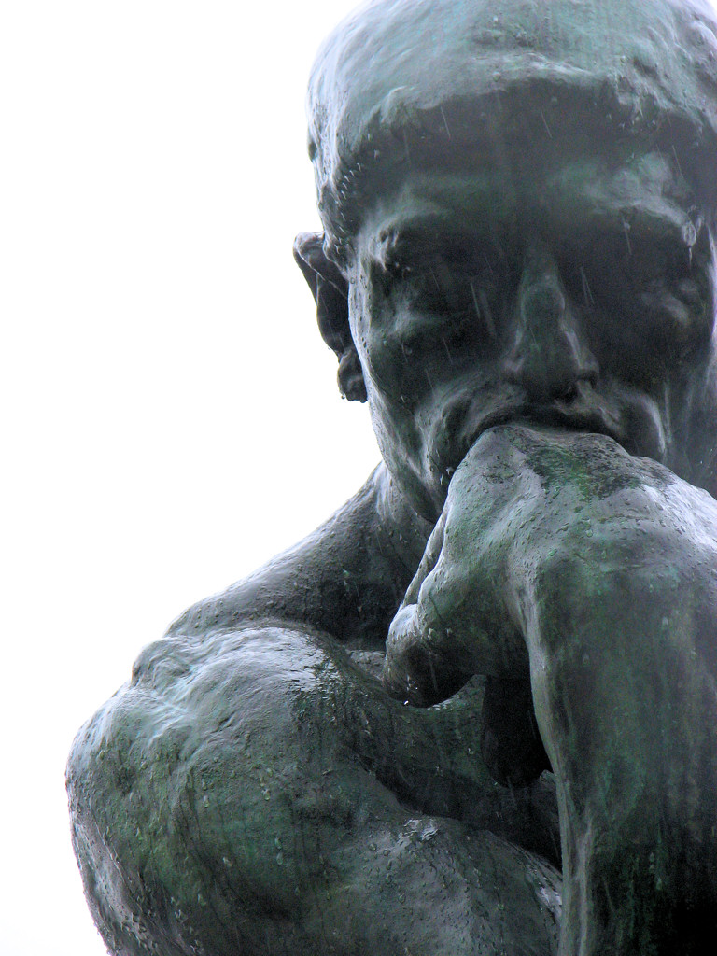
Why philosophy and values matter for collaboration
The Thinker, Auguste Rodin, 1902

Slide 29
Implementation of the toolbox for philosophical dialogue from Eigenbrode et al., 2007
Get background on underlying philosophical structure
Reflect on questions and individual responses
Discuss responses among team
Notes:
Epistemology is the investigation of what distinguishes justified belief from opinion. The theory of knowledge
Metaphysics is a branch of philosophy concerned with explaining the fundamental nature of being and the world,^{[1]} although the term is not easily defined.^{[2]} Traditionally, metaphysics attempts to answer two basic questions in the broadest possible terms:
"What is there?"
"What is it like?"^{[3]}

Slide 30
Toolbox for philosophical dialogue from Eigenbrode et al., 2007
Motivation: Is applied research or basic research more important to you as a researcher?
Methodology: In your typical disciplinary research, what methods do you use, and which are most appropriate for your (hypothetical) collaborative study (e.g., quantitative, qualitative, experimental, case study, observational, modeling)?
Confirmation: What type and amount of evidence are required for knowledge in your work?
Objectivity: Must scientific research be objective to be legitimate?
Values: Is value-neutral scientific research possible?
Reductionism and emergence: Can the world under investigation be fully reduced to individual, independent elements for study?
Notes:
Epistemology is the investigation of what distinguishes justified belief from opinion. The theory of knowledge
Metaphysics is a branch of philosophy concerned with explaining the fundamental nature of being and the world,^{[1]} although the term is not easily defined.^{[2]} Traditionally, metaphysics attempts to answer two basic questions in the broadest possible terms:
"What is there?"
"What is it like?"^{[3]}

Slide 31
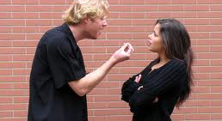
Dealing with conflict and emotions

Slide 32
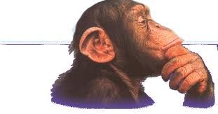
You are a scientist
Do you consider yourself objective, data-driven, and rational?
  → This may describe your approach to science, but perhaps not your emotional response to people and situations as you conduct research
Emotions can influence the way you interact with others and how you make decisions- all of this affects how well research teams function
Image: http://decodingcommunications.blogspot.com

Slide 33
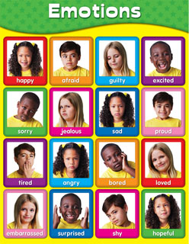
The impact of emotional reactions
Narrowed vision and creativity
Stifled curiosity, openness, and playfulness
Hindered ability to recognize nuances
Distorted perceptions
→ Reduced capacity for collaboration

Slide 34
How to handle conflict
Understand the culture and context
Actively listen
Acknowledge emotions
Focus on how to satisfy mutual needs, not who is right or wrong
Understand why others might be resistant to change
Solve problems creatively and negotiate collaboratively

Slide 35
Thomas-Kilman Conflict Modes
Competing
-zero sum orientation
-win/lose power struggle
Collaborating
-expand range of possible outcomes
-achieve win-win outcomes
Assertiveness
-focus on MY needs, desired outcomes, and agenda
Compromising
-minimally acceptable to all
-relationships undamaged
Avoiding
-withdrawn from situation
-maintain neutrality
Accommodating
-accede to other party
-maintain harmony
Cooperativeness
-focus on OTHERS’ needs and mutual relationships

Slide 36
Dialog versus Debate
Case Study 14
Notes:
reco

Slide 37
Dialog versus Debate
Collaborative- two sides working together toward common understanding
Because finding common ground is the goal, one searches for a basis of common ground
Creates an open-minded attitude and openness to being wrong and change
Search for strengths in other positions
Helps reveal and re-examine assumptions that may be feeding conflict
Opens the possibility of reaching a better solution than the original solution
Reveals concern for the other party and seeks not to alienate or offend
Oppositional- two sides oppose each other and try to prove each other wrong
Winning is the goal, one searches for differences and weaknesses
Creates closed-minded attitude and a determination to be right
In debate, one searches for flaws and weaknesses in the other position
Defends assumptions as unquestionable
Defends one’s own position as the best solution and excludes others solutions
Involves countering the other position without regard for feelings or relationships
Notes:
reco

Slide 38
Recognizing interpersonal conflict versus scientific disagreement
Science thrives on disagreement and discussion (somewhere between dialog and debate)
Interpersonal conflict can be destructive
→ de-personalize scientific disagreements

Slide 39
Adversarial scientific collaboration
Empirical resolution of scientific disputes through facilitated collaboration
Jointly designed studies that speak to disputed issues and narrow or clarify differences
Agreement of all parties on an experimental design and approach for resolving a dispute
Conduct agreed-upon tests with the help of a neutral third party scientist mediator/arbiter

Slide 40
Preconditions for Adversarial Scientific Collaboration
All parties must
Acknowledge the possibility that conflicting hypotheses might be the result of differences in the way experiments have been conducted
Engage a mutually agreed-upon and trusted third party
Ensure that differences are not too deep or philosophical

Slide 41
The Process for Adversarial Scientific Collaboration
Systematically review relevant literature
Formulate hypotheses
Discuss, develop, and implement procedures to test hypotheses
Analyze and re-analyze data
Engage outside experts as needed

Slide 42
The risks and rewards of adversarial scientific collaboration
Risks
  Ego threatening
  Possibility of being wrong
  Personal animosity or competition
  Idealogical/theoretical/paradigmatic differences
Rewards
  Surprising results
  Insightful discussions

Slide 43

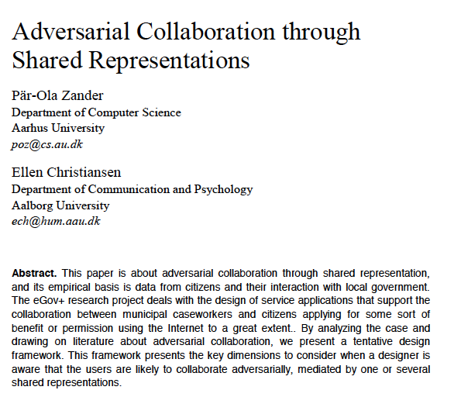
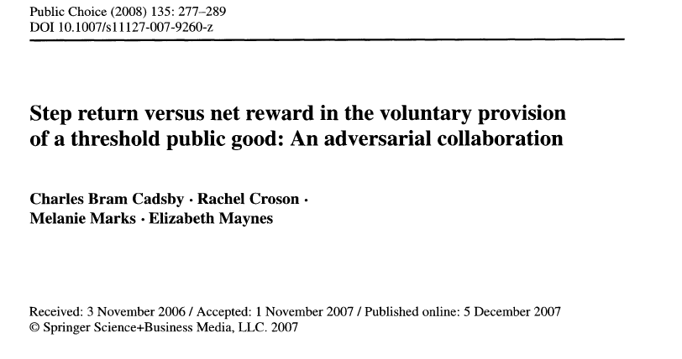
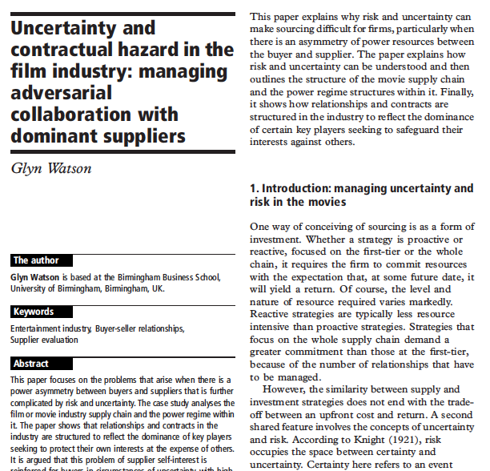
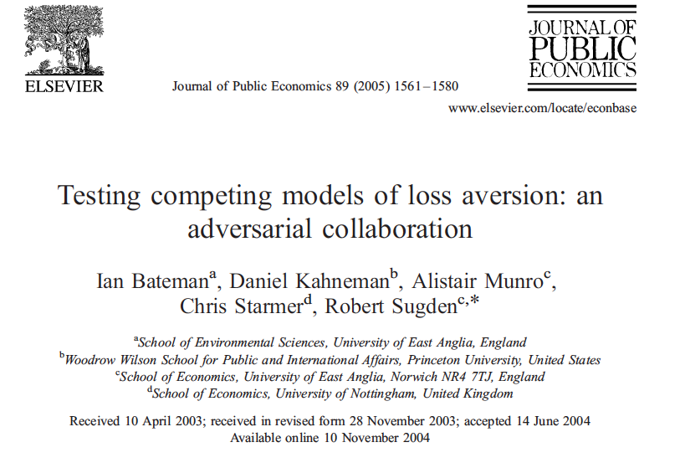
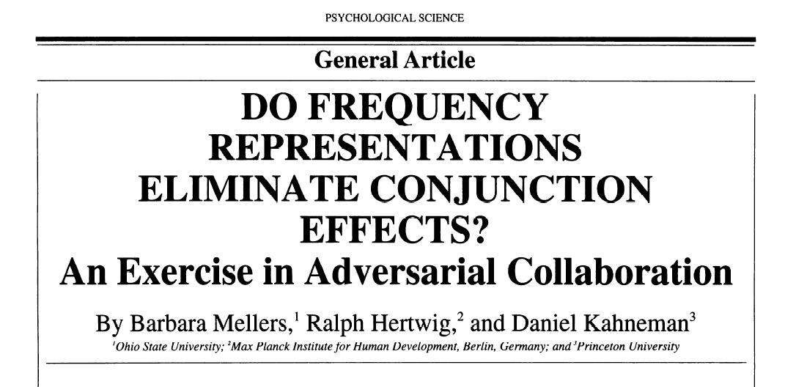
Examples of adversarial collaboration

Slide 44
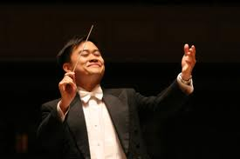
Leading team science
Channing Yu, musical director of the Mercury Orchestra in Cambridge, MA. Photo: Rick Peckham

Slide 45
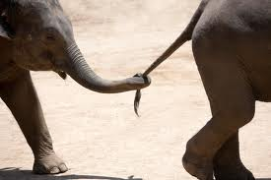
Ways to lead
Model and motivate others in the collaborative approach
Support and empower team members in the goals and objectives of the team
Delegate responsibilities and manage team expectations

Slide 46
Ways not to lead
Absentee- unavailable or insufficiently involved
Inhibited- avoiding conflict and reluctant to handle difficult people or situations
Defensive- resistant to feedback regarding systemic problems, projecting blame outward
Hostile leadership- actively promoting competition and conflict within the lab

Slide 47
Conclusions

Slide 48
Team science
Communication
Trust
Dealing with conflict
Setting expectations

Slide 49
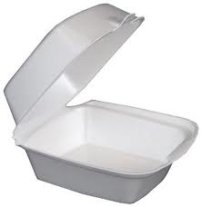
Take-home message
Communication
  Encourage debate, constructive feedback, and sharing by all team members
Trust
  Mutual respect
  Connecting in different settings (i.e. socializing)
Dealing with conflict
  Prevent and be prepared for interpersonal conflicts
  Focus on how to satisfy mutual needs, not who is right or wrong
Shared goals and shared success (establishing expectations)
  Vision statement
  Collaborative agreement
  Authorship policy
→ Collaborations can start small

Slide 50

Image: woodleywonderworks Flicker Stream

Slide 51
“Even those unplanned meetings in the hallway bolster the sense of being on the same team.”
  Julie Segre, National Human Genome Research Institute
“Biggest lesson learned: Not being closed to things outside your comfort zone is important. You never know where it will take you.”
  Malcolm Gardner, Seattle Biomedical Research Institute
“It was very clear that people here actually liked each other and wanted to work together.”
  Marcus Bosenberg, Yale University

