Slide 1
Goals of this workshop
You should:
Have a basic understanding of Bayes theorem and Bayesian inference.
Write and implement simple models and understand range of possible extensions.
Be able to interpret work (talks and articles) that use a Bayesian approach.
Have vocabulary to pursue further study.

Slide 2
Frequentist
How likely are these data given model M?
Bayesian
What is probability of model M given the data?

Slide 3
Frequentist
How likely are these data given model M?
Data Model
Bayesian
What is probability of model M given the data?
Prior * Data Posterior
Model

Slide 4
Do you have TB?
…or is it just allergies

Slide 5
Do you have TB?
Data:
Positive test (+)
Is it time to panic?

Slide 6
Do you have TB?
Background/Prior Information:
Population incidence = 0.01 or 1%
Imperfect data:
P(+/Inf)= 95%
P(-/Inf)= 5% [false negative]
P(+/uninf) = 5% [false positive]

Slide 7
Do you have TB?
Background/Prior Information:
Population incidence = 0.01 or 1%
Imperfect data: P(Test +/Inf)= 95%
P(-/Inf)= 5% [false negative]
P(+/uninf) = 5% [false positive]
What is the probability that you have TB, given that you tested positive
P(Inf/+)
??

Slide 8
Do you have TB?
P(Inf) = 0.01 = Background probability of infection
P(+/Inf) = 0.95
P(-/Inf)= 0.05
P(+/uninf) =0.05
The probability that you test + (with or without TB) is sum of all circumstances that might lead to + test,
P(+) = P(+/Inf) * P(Inf) + P(+/uninf) * P(uninf)
=(0.95*0.01) + (0.05*0.99) = 0.059

Slide 9
What is the probability that you have TB, given that you tested positive?
P(Inf/+) = P(+/Inf) * P(Inf)
P(+)

Slide 10
What is the probability that you have TB, given that you tested positive?
P(Inf/+) = P(+/Inf) * P(Inf)
P(+)
P(Inf/+) = 0.95* 0.01 = 0.161
0.059
P(Inf) = 0.01
P(+/Inf) = 0.95
P(-/Inf)= 0.05
P(+/uninf) =0.05
P(+) =0.059

Slide 11
What is the probability that you have TB, given that you tested positive?
P(Inf/+) = 16%
P(Inf) = 0.01
P(+/Inf) = 0.95
P(-/Inf)= 0.05
P(+/uninf) =0.05
P(+) =0.059

Slide 12
What is the probability that you have TB, given that you tested positive?
P(Inf/+) = 16%
P(Inf) = 0.01
P(+/Inf) = 0.95
P(-/Inf)= 0.05
P(+/uninf) =0.05
P(+) =0.059
1/100 test positive and are positive
About 5/100 test positive by accident
Of 6 + tests, only 1/6 (16.7%) is actually infected.
[Testing + (new data) made you 16% more likely to have TB than you were before the test.]

Slide 13
A Bayesian Analysis uses probability theory (Bayes Theorem) to generate probabilistic inference
P(ϴ /y) = P(y/ϴ)P(ϴ)
P(y)
The posterior distribution (P(ϴ /y) describes the probability model or parameter value ϴ given the data y.
P(y/ ϴ ) = likelihood, a base for most statistic paradigms
P(ϴ ) = prior, background understanding of model
P(y) = marginal likelihood, a normalizing constant to ensure posterior sums to 1.

Slide 14
Some Probability Theory
For events A and B,
Pr(A,B) stands for the joint probability that both events happen.
Pr(A|B) is the conditional probability that A happens given that B has occurred.
If two events A and B are independent:
Pr(A,B) = Pr(A)Pr(B)
Then,
P(A|B) P(B) = P(A,B)
and
P(B|A) P(A) = P(A,B)
It follows that:

Slide 15
What is the probability that you have TB, given that you tested positive?
P(Inf/+) = P(+/Inf) * P(Inf)
P(+)
P(Inf) = 0.50 == An objective (‘noninformative’) prior
P(+/Inf) = 0.95
P(-/Inf)= 0.05
P(+/uninf) =0.05
P(+) ==(0.95*0.50) + (0.05*0.99) = 0.50

Slide 16
What is the probability that you have TB, given that you tested positive?
P(Inf/+) = P(+/Inf) * P(Inf)
P(+)
P(Inf) = 0.50 == An objective (‘noninformative’) prior
P(+/Inf) = 0.95
P(-/Inf)= 0.05
P(+/uninf) =0.05
P(+) ==(0.95*0.50) + (0.05*0.99) = 0.50
P(Inf/+) = 0.95* 0.05 = 0.95
0.50
*using an uninformative prior just returns the likelihood value, based on an initial belief that 50% people are infected.

Slide 17
 | Frequentist | Bayesian
Probability | Long-run relative frequency with which an event occurs in many repeated trials. | Measure of one’s degree of uncertainty about an event.
Inference | Evaluate the probability of the observed data, or data more extreme, given the hypothesized model (H0) | Evaluating the probability of a hypothesized model given observed data
Measure | A 95% Confidence Interval will include the fixed parameter in 95% of the trials under the null model | A 95% Credibility Interval contains the parameter with a probability of 0.95.
The Frequentist definition of probability only applies to inherently repeatable events, e.g., from the vantage point 2013, PF (the Republicans will win the White House again in 2016) is (strictly speaking) undefined.
All forms of uncertainty are in principle quantifiable within the Bayesian definition.

Slide 18
 | Frequentist | Bayesian
Probability | Long-run relative frequency with which an event occurs in many repeated trials. | Measure of one’s degree of uncertainty about an event.
Inference | Evaluate the probability of the observed data, or data more extreme, given the hypothesized model (H0) | Evaluating the probability of a hypothesized model given observed data
Measure | A 95% Confidence Interval will include the fixed parameter in 95% of the trials under the null model | A 95% Credibility Interval contains the parameter with a probability of 0.95.

Slide 19
Bayesian Model framework
Prior *
Likelihood (DATA) ~
Posterior Probability
P(y/ϴ)
P(ϴ)

Slide 20
Bayesian Model framework
Prior *
Likelihood (DATA) ~
Posterior Probability
P(ϴ/y )
P(y/ϴ)
P(ϴ)

Slide 21
Bayesian Model framework
Prior *
Likelihood (DATA) ~
Posterior Probability
Mean
95% CI
Extremes
...
P(ϴ/y )

Slide 22
Data = Y (observations y₁…y_{N})
Parameter =µ
Likelihood for observation y for a normal sampling distribution:
y ~ Norm (µ,σ²)

Slide 23
Data = Y (observations y₁…y_{N})
Parameter =µ
Likelihood for observation y for a normal sampling distribution:
y ~ Norm (µ,σ²)
µ ~ Norm (µ,τ²)

Slide 24
Data = Y
Parameter =µ
Likelihood for observation y for a normal sampling distribution:
y ~ Norm (µ,σ²)
µ ~ Norm (µ,τ²)
P(µ|y, σ, τ) ~ Norm (µ,σ²)

Slide 25
Data = Y (observations y₁…y_{N})
Parameter =µ
Likelihood for dataset Y for a normal sampling distribution:
Y ~ Norm (µ,σ²)
]

Slide 26
MCMC
Gibbs sampler = Algorithm for I iterations for y~ f(μ,σ):
1. Select initial values μ(0) and σ(0)
2. Sample from each conditional posterior distribution, treating the other parameter as fixed.
for(1: I){
sample μ(i)| σ(i-1)
sample σ(i)| μ(i)
}
This decomposes a complex, multi-dimension problem into a series of one-dimension problems.

Slide 27
Spatial Lake example in WinBUGS

Slide 28
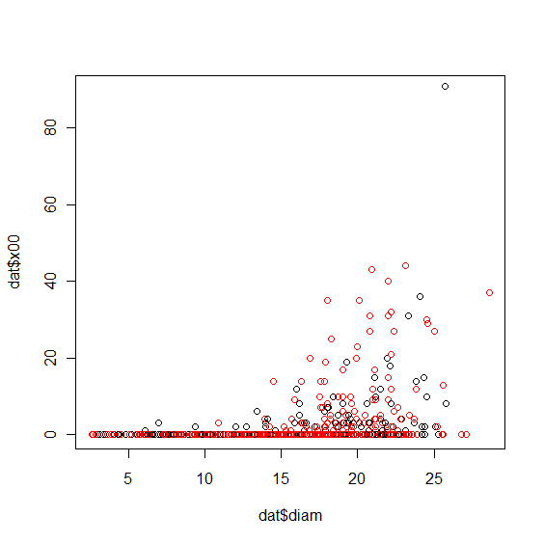
Hierarchical Bayes
Y = 0 + mX + ɛ
ɛ
= error (assumed)
in data sampling.

Slide 29
Hierarchical Bayes
Y = 0 + mX + ɛ
ɛ
= error (assumed)
in data sampling.
This error doesn’t get
propagated forward in
predictions.

Slide 30
Why Hierarchical Bayes?
Ecological systems are complex
Data are a subsample of true population
Increasing demand for accurate forecasts

Slide 31
Why Hierarchical Bayes (HB)?
Ecological systems are complex
Data are a subsample of true population
Increasing demand for accurate forecasts
Analyses should accommodate these realities!
Notes:
HB modeling allows us to address all these issues

Slide 32
Hierarchical Analysis
Hierarchical Model
Standard Model
Y ~ mX+b + ɛ
Data
Process
Parameters
Z ~x + ɛ._{obs}
Y ~mZ+b + ɛ._{proc}
m, b, ɛ
m,b, ɛ._{proc,} ɛ._{obs}

Slide 33
Hierarchical Analysis
Bayesian Hierarchical Model
Data
Process
Parameters
Hyperparameters
Z ~x + ɛ._{obs}
Y ~mZ+b + ɛ._{proc}
m, b, ɛ._{proc,} ɛ._{obs}
σ²_{m}, σ²_{b}

Slide 34
Hierarchical Analysis
Data: P(Y) ~ Pois(λ)
Process:
log (λ) = f(state, size, η)
η denotes stochasticity, could be random, spatial
Parameters:
(α_{p}, η)
Hyperparameters:
(σ_{α}, σ _{η})

Slide 35
Bayesian Hierarchical Analysis
The joint distribution [process,parameters| data]=
[data|process, parameters] * [process|parameters] * [parameters]

Slide 36
Bayesian Hierarchical Analysis
The joint distribution [process,parameters| data]=
[data|process, parameters] * [process|parameters] * [parameters]
P(P, θ.p, θ.d|D) = (D|P, θ.p, θ.d)*(P, θ.p, θ.d)
(D)

Slide 37
Bayesian Hierarchical Analysis
The joint distribution [process,parameters| data]=
[data|process, parameters] * [process|parameters] * [parameters]
Bayes Theorem
P(P, θ.p, θ.d|D) = (D|P, θ.p, θ.d)*(P, θ.p, θ.d)
(D)

Slide 38
Bayesian Hierarchical Analysis
The joint distribution [process,parameters| data]=
[data|process, parameters] * [process|parameters] * [parameters]
Bayes Theorem
P(P, θ.p, θ.d|D) = (D|P, θ.p, θ.d)*(P, θ.p, θ.d)
(D)
Probability theory shows:
∞ (D|P,θ.d)*(P| θ.p)* (θ.p, θ.d)
… a series of low dimension conditional distributions.

Slide 39
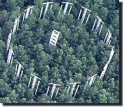
HB Example
Question: Do trees produce more seeds when grown at elevated CO₂?
Design: 50-100 trees in 6 plots, 3 at ambient and 3 elevated
Data: Fecundity time series (#cones) on trees and seeds on ground.
[Seeds per pine cone: 83 +/- 24 (no CO2 effect)]

Slide 40
The fecundity process is complex…
Intervention
Trees reach maturity
Tree responses
1996 through 1998 ….pretreatment
Change of scale:
seeds in plots to cones on individuals.
Trees grow
Cone counts on FACE trees
Data
Seed collection at FACE
Pretreatment
phase
Design
Fumigation
CO₂ treatment: reproduction
control
1996 1998 2000 2002 2004

Slide 41
…and nature is tricky.
Intervention
Mortality
Trees reach maturity
Tree responses
Trees grow
Data
Cone counts on the FACE trees
Seed collection in the FACE
Interannual differences
Pretreatment
phase
Ice storm
damage
Design
CO2 treatment
fumigation
control
1996 1998 2000 2002 2004

Slide 42
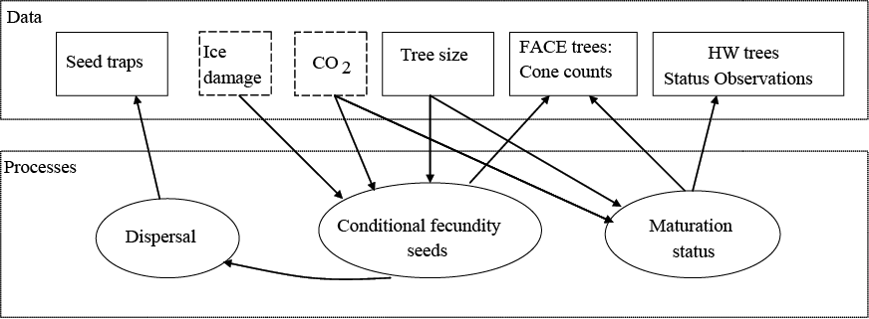
Modeling Seed Production
Maturation is estimated for all trees with unknown status.
Fecundity is only modeled for mature trees.

Slide 43
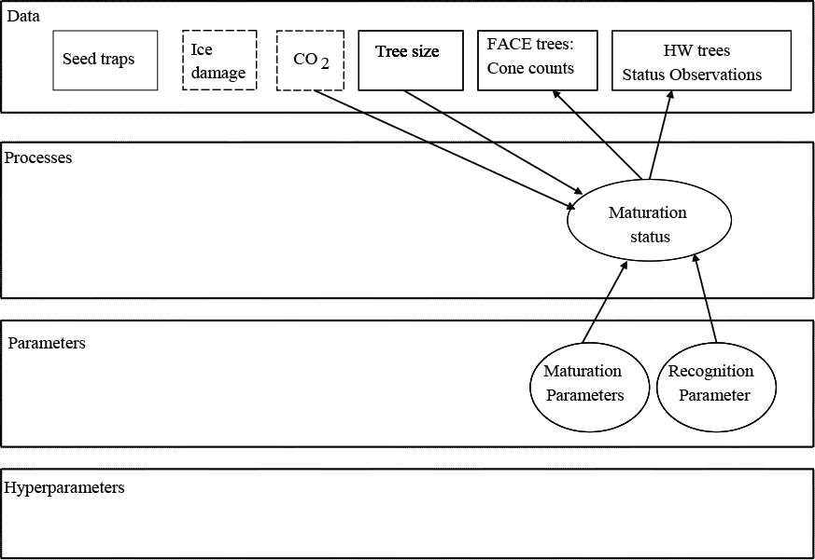
Modeling Seed Production
Probability of being mature = f (diameter)

Slide 44
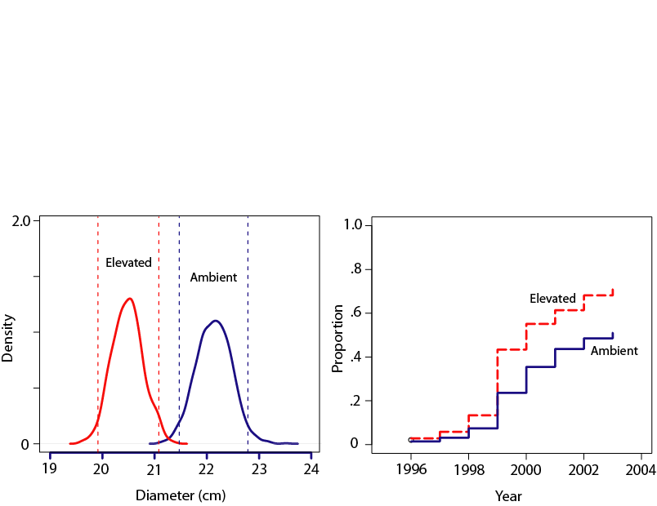
Modeling Seed Production
Trees mature at smaller diameters in elevated CO₂. More young trees have matured in high CO₂.
Notes:
Even though trees are growing faster, they are actually initiating reproduction at smaller diameters.

Slide 45
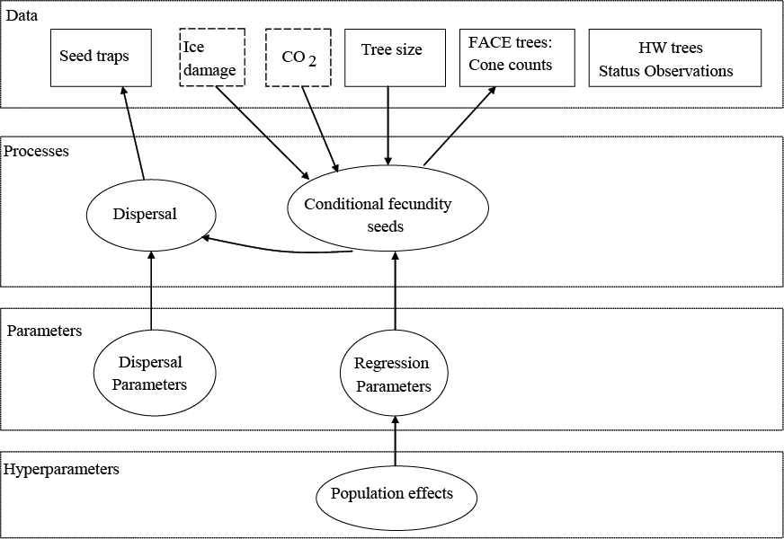
Modeling Seed Production
(# & location)
(# & location)
Dispersal model and priors:
Clark, LaDeau and Ibanez 2004
Seed production =
f(CO₂, diameter, ice storm, year effects)

Slide 46
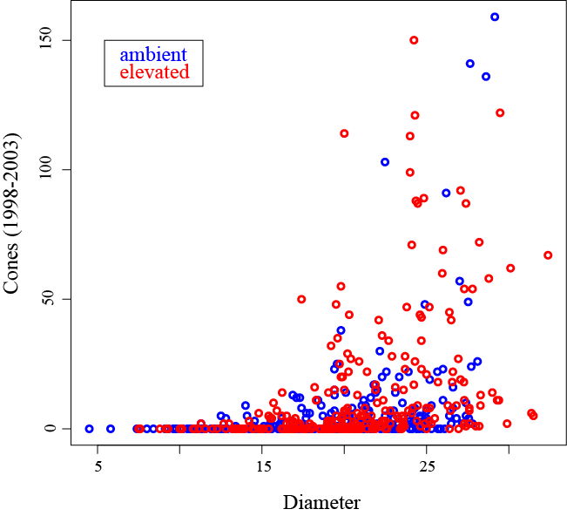
At diameters of
24 cm to 25 cm
mean Ambient cones= 7
mean Elevated cones= 52

Slide 47
Modeling Seed Production
Seed production =
f(CO2, diameter, ice storm,
year effect)
Random intercept model:
We also allow seed production to vary among individuals.

Slide 48
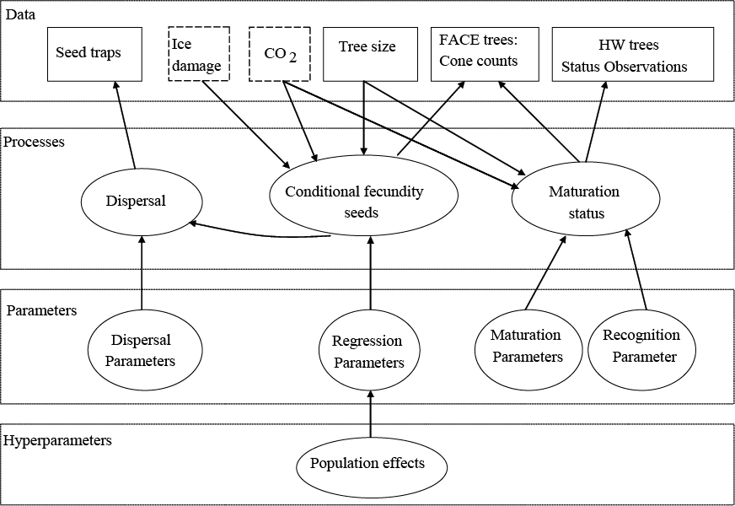
Seed Production: Bayesian Hierarchical Model

Slide 49
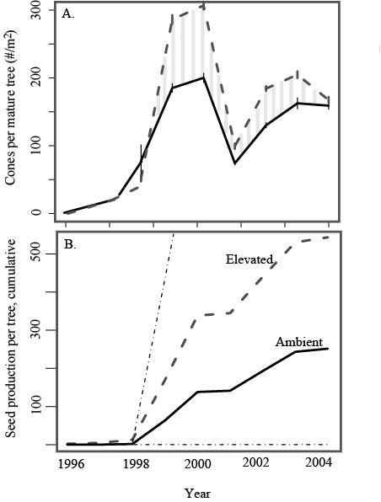
Mature trees in the high CO₂ plots produce up to 125 more cones per tree than mature ambient trees.
Notes:
95 % CIS in bottom panel include random effects – largest source of variation.

Slide 50
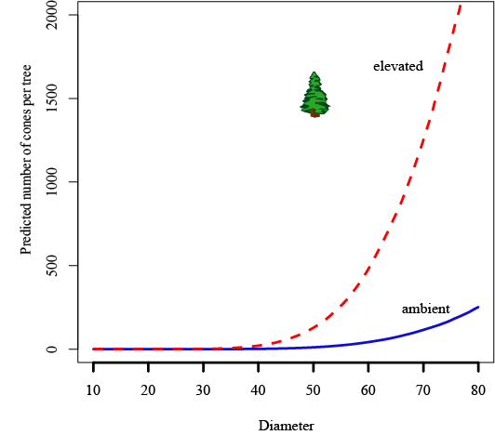
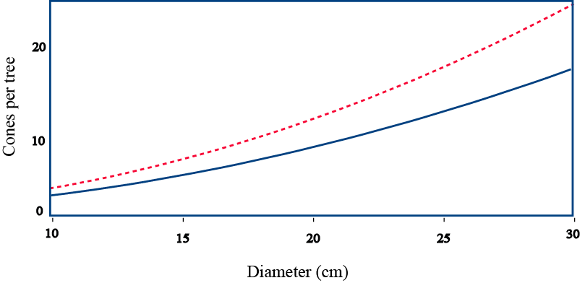
Model predictions suggest even larger enhancement of cone productivity as trees age.
Cones per tree
(model prediction)
*
* Wahlenberg 1960
Notes:
Assuming constant CO2 effect…
Open grown tree cone count from 1960 = model predictions not unrealistic.

Slide 51
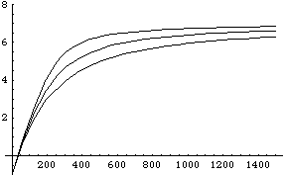
HB Example 2
The problem: Leaf-level photosynthesis rates are fxn(light). The increase in photosynthesis rate as a function of light is described by a “light response curve”, which differs among species and individuals (and leaves).
Net photosynthesis (µmol CO₂ m^{–2} s^{–1})
Pn represent “net” photosynthesis and Q light intensity. Features of the curve (Fig. 1A) include: (i) the y-intercept is the “dark” respiration rate (Rd) such that Pn = –Rd when Q = 0
Light intensity (µmol photon m^{–2} s^{–1})

Slide 52
The data: 14 plants from 4 different species. For each plant, light levels were systematically decreased from 2000 to 0 μmol m^{–2} s^{–1}, resulting in 12 to 14 different light levels per plant. Photosynthesis was measured at each of the light levels, and the total number of measurements is N = 174.
Net photosynthesis (µmol CO₂ m^{–2} s^{–1})
Light intensity (µmol photon m^{–2} s^{–1})

Slide 53
The Model:
Assume:
the observed data are normally distributed around a mean given by the above equation,
each individual plant gets it own set of parameters (Pmax, Rd, α, θ),
the plant-level parameters come from distributions whose means are defined by the species identity of the plant, and
the species-level parameters arise from an overall population of light response parameters.

Slide 54
Coding a process model:
part1[i] <- alpha[Plant[i]]*Q[i] + Pmax[Plant[i]]
part2[i] <- 4*alpha[Plant[i]]*Q[i]*theta[Plant[i]]*Pmax[Plant[i]]
part3[i] <- sqrt(pow(part1[i],2) - part2[i])
AQcurve[i] <- (part1[i] - part3[i])/(2*theta[Plant[i]])
mu.Pn[i] <-AQcurve[i]-Rday[Plant[i]]
}

Slide 55
for (i in 1:N){
# Likelihood for non-linear photosynthetic response to light (Q)
Pn[i] ~ dnorm(mu.Pn[i],tau.Pn)
# Predicted photosynthesis response given by non-rectangular hyperbola
mu.Pn[i] <-AQcurve[i]-Rday[Plant[i]]
part1[i] <- alpha[Plant[i]]*Q[i] + Pmax[Plant[i]]
part2[i] <- 4*alpha[Plant[i]]*Q[i]*theta[Plant[i]]*Pmax[Plant[i]]
part3[i] <- sqrt(pow(part1[i],2) - part2[i])
AQcurve[i] <- (part1[i] - part3[i])/(2*theta[Plant[i]])
}
#Hierarchical structure #plant level variability
for (p in 1:Nplant){
Rday[p] ~ dnorm(mu.Rday[species[p]],tau.Rday)
Pmax[p] ~ dnorm(mu.Pmax[species[p]],tau.Pmax)
alpha[p] ~ dnorm(mu.alpha[species[p]],tau.alpha)
theta[p] ~dnorm(mu.theta[species[p]],tau.theta)I(0,1)
}

Slide 56
State-Space Models
The purpose of a state-space model is to estimate the state of a time-varying system from noisy measurements obtained from it.
Classical approach: Kalman filter – an iterative procedure to identify underlying state (X), given that Y is observed. Often used to predict Y(t+j) at some time in the future (given that Y and not X will continue to be observed). [But KF isn't easily extended to nonlinear models of the transition function f(x_{t}).
Hence, a Bayesian alternative.

Slide 57
Time Series
x_{t} = f(x_{t-1}) + ɛ_{t}
ɛ_{t ~} N(0,σ²) iid
Y_{t-1} Y_{t} Y_{t+1}
Data model
σ²
Parameter model
Process Error propagates forward with the process (versus observation error - which does not).
Data are generated to represent some 'true' population. Missing data, observation errors, etc can obscure 'signal‘ in
Parameters.
Notes:
Conditional relationships are arrows. Random walk model with process stochasticity.

Slide 58
State-Space Models
x_{t} = f(x_{t-1}) + ɛ_{t}
y_{t} = f(y_{t-1}) + w_{t}
ɛ_{t ~} N(0,σ²) iid
w_{t} ~ N(0,σ²) iid
Y_{t-1} Y_{t} Y_{t+1}
Data model
X_{t-1} X_{t} X_{t+1}
Process model
τ²
σ²
Parameter models
Notes:
State-space random walk.

Slide 59
Ricker model example
AR model example

